Slide 1

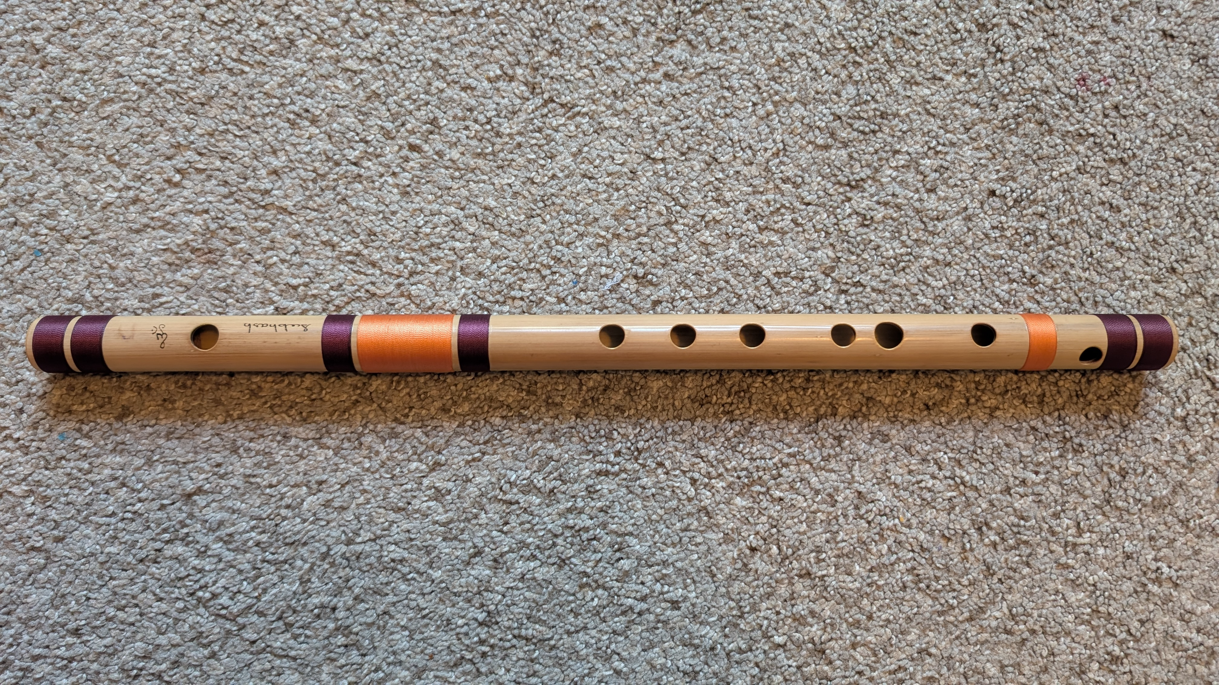
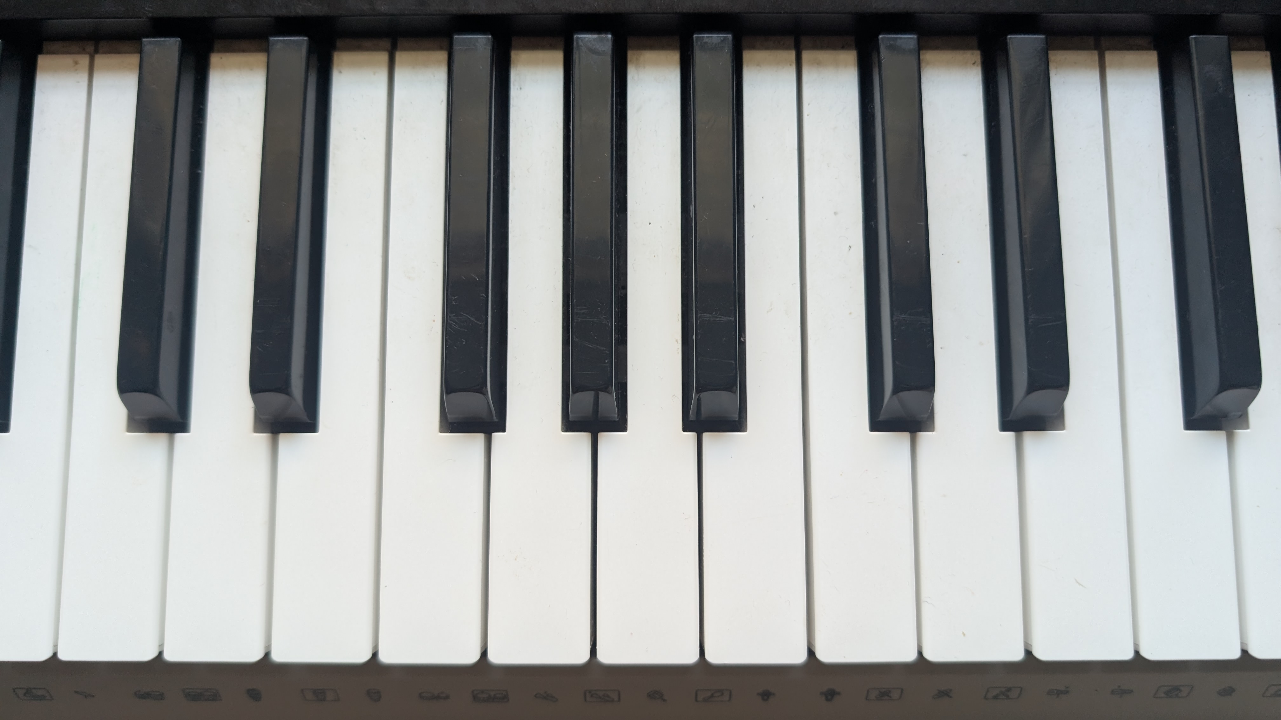
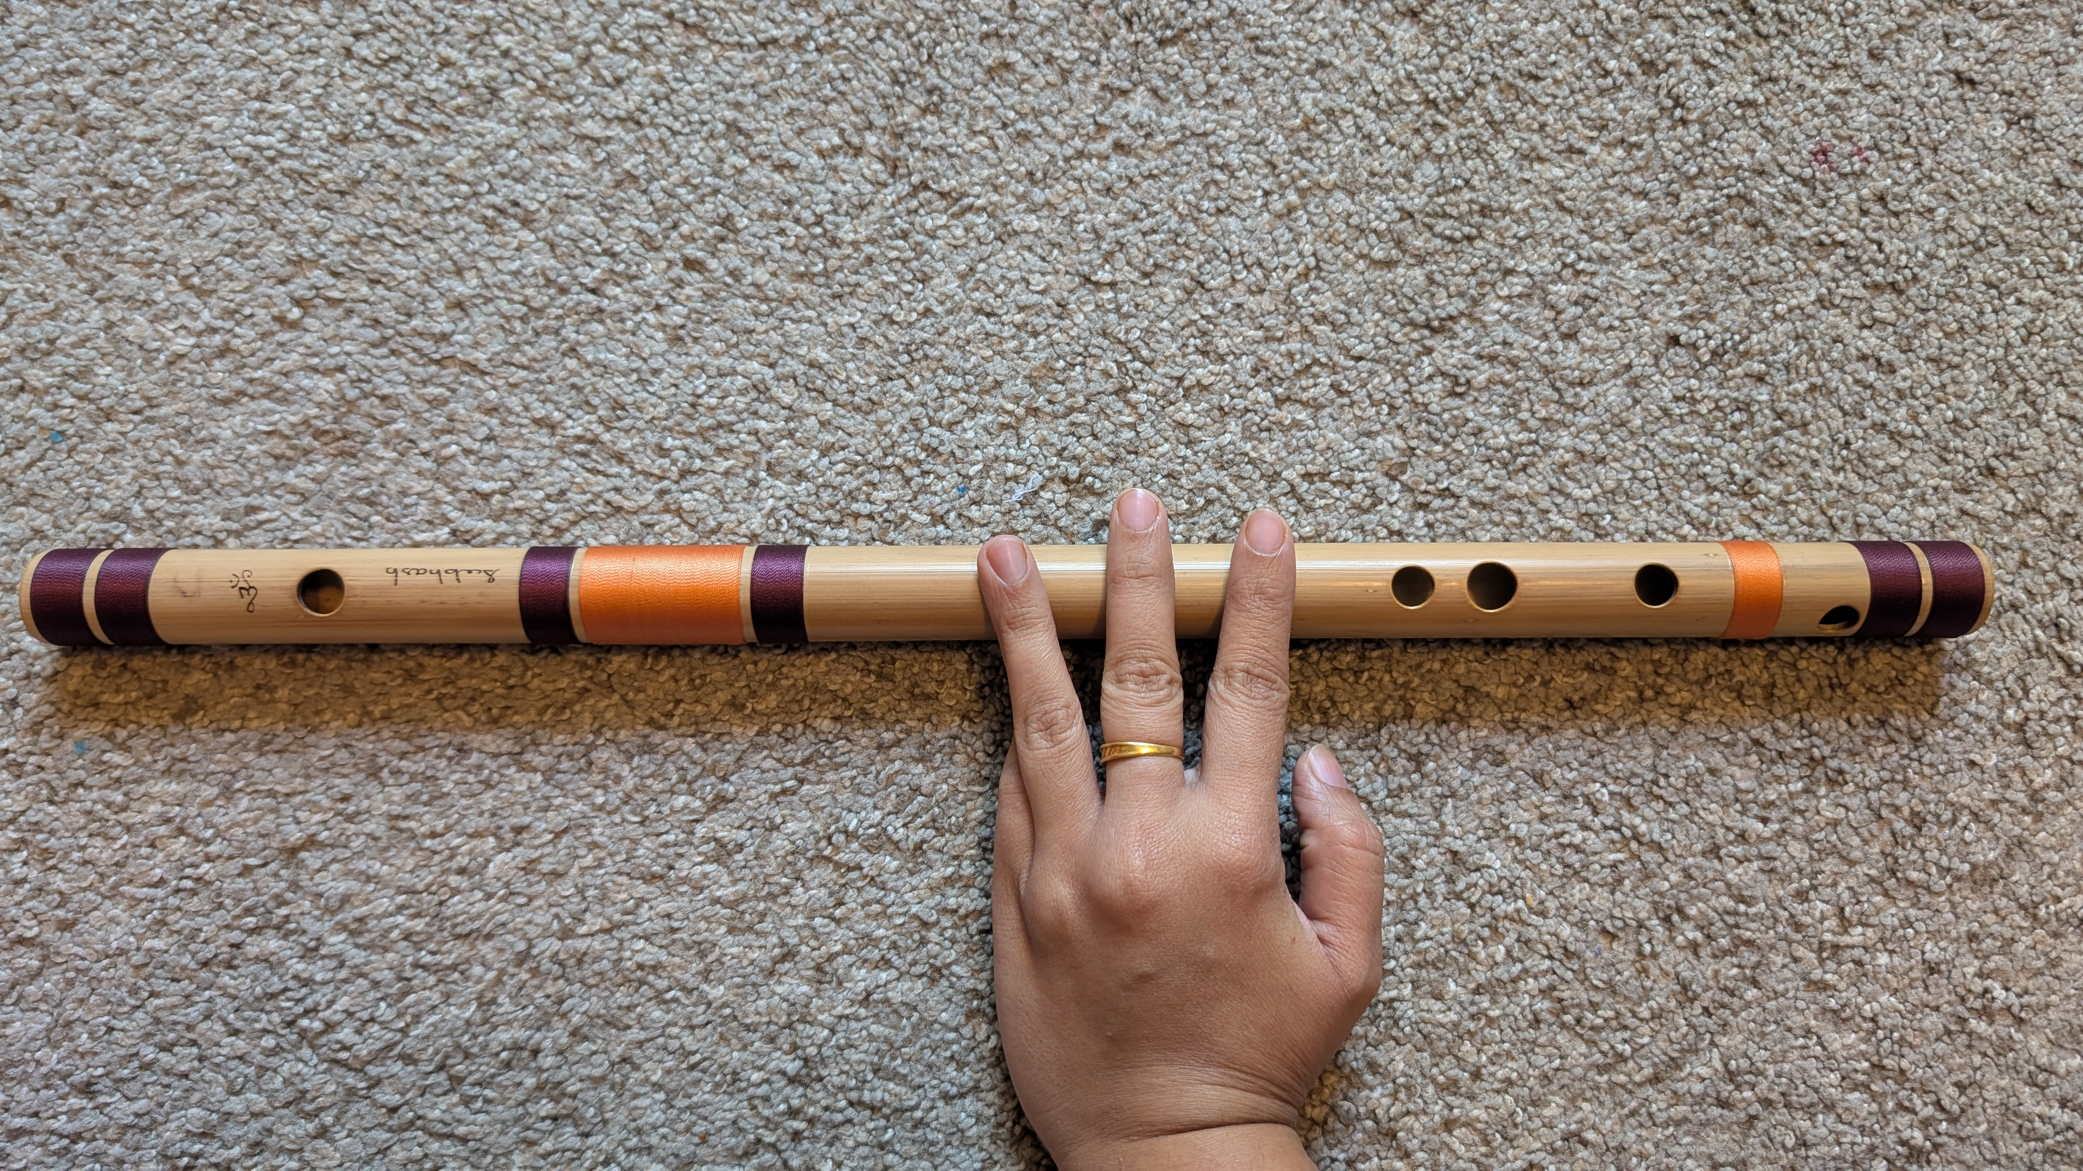
Waves and Music Virata Pusuluri, Grade 1, Nirmala Vishwa Vidya Peetham (Home School), Dunwoody GA (Dekalb County)
Waves properties and music: A wave is a disturbance that keeps moving up and down, or left and right in a systematic way just like when we drop a stone in water. We use Python programming to study wave properties like wavelength (λ), frequency (𝛎), amplitude (A), velocity (V) and attenuation factor (f) and check how these wave properties control musical sounds on a flute or a piano.
Changing A
Figure 1: Waves on water surface (AI generated)
Changing λ or 𝛎
attenuation f>0
Figure 2: Changing wave properties – λ/𝛎, A, and f while keeping V fixed.
F#3
F#3
C3
C4
C3
Figure 3: Wave property λ decreases and 𝛎 increases as we move from the note C3 to a higher note F#3 on a flute/piano. A controls volume, V doesn’t change for sound in air, f is higher for piano than harmonium.
Methods: We used Python libraries and Google Gemini AI to create functions to plot waves and play Indian Carnatic music songs based on musical notes.
def create2D1DWaves( wavePropertiesAsParameters )
…
return
def playMusicFromNotes( musicalNotesAsParameters )
…
return
Scientific Method: (order not strictly followed)
Question? Wave properties and musical sounds
Experiment and Data Collection? Modeling with python
Hypothesis? Changing wave properties (λ, 𝛎 , f and A) change musical sounds
Testing? Flute, piano, python
Conclusion? 𝛎/λ change musical notes, A changes volume, f is higher for piano and lower for harmonium.
References:
1.PyCharm https://www.jetbrains.com/pycharm/
2. Google Gemini AI
https://gemini.google.com/
3. OpenStax Physics https://openstax.org/details/books/physics

